Slide 1
CHETTINAD COLLEGE OF ENGINERRING AND TECHNOLOGY
SMART HELMET FOR COAL MINERS
S. Janaki (22CS017 )
P. Jeevitha (22CS019 )
S. Priyadharshini (22CS042 )

Slide 2
ABSTRACT
The Smart Helmet for Coal Miners is a revolutionary solution designed to enhance safety and efficiency in coal mining operations. This innovative helmet integrates various sensors and communication modules to detect hazards such as gas leaks and monitor environmental conditions in real-time. By providing early warnings and actionable insights, the smart helmet significantly reduces the risk of accidents and improves the overall well-being of miners. Through this project, we aim to address the pressing safety challenges faced by coal miners and pave the way for a safer and more productive mining industry.

Slide 3
OBJECTIVE

Slide 4
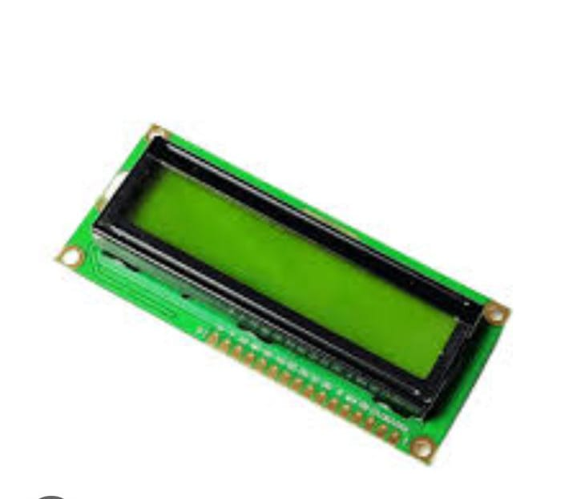
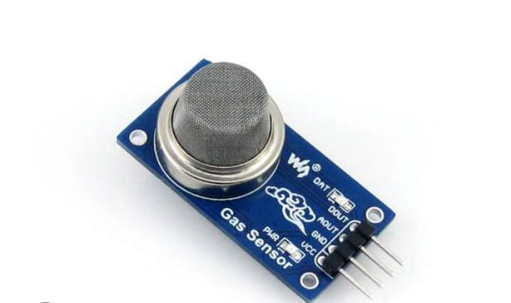
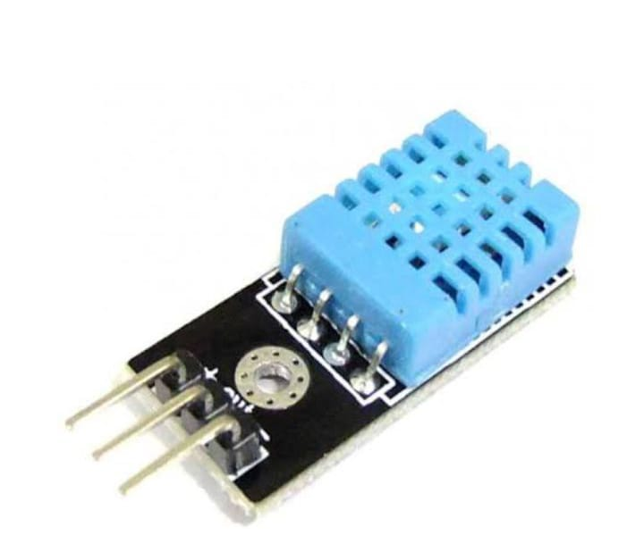
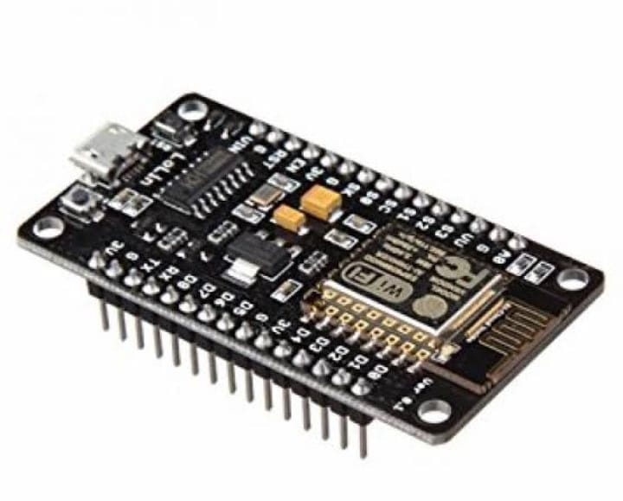
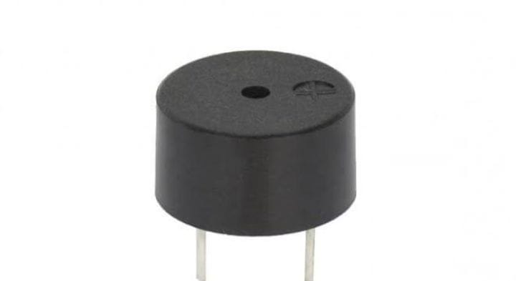
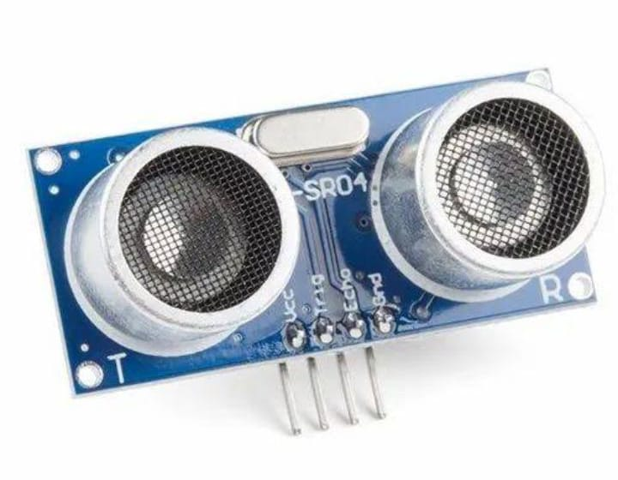
COMPONENTS
Gas sensor
LCD display
Temperature and humidity sensor
Node MCU-ESP8266
Ultrasonic sensor
Buzzer

Slide 5
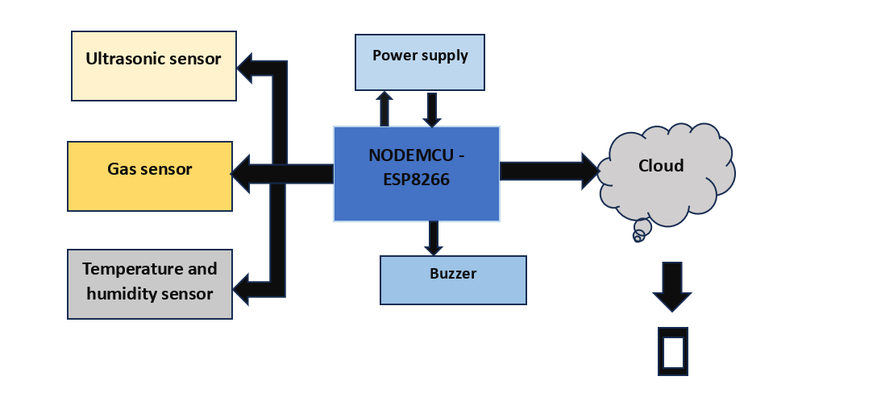
ARCHITECTURE

Slide 6
WORKING
First of all, the gas sensor, ultrasonic sensor, buzzer, temperature and humidity sensor are connected to the NODEMCU.
And after that, the sensors starts sensing the environment.
The gas reading, temperature and humidity reading will be taken by the sensors.
If any hazardous gas, high temperature are found means, it will send the notification to the phone through blynk app and also it will produce sound through buzzer.

Slide 7
MODULES
1. Environmental Monitoring Module
Gas Sensors: Detect harmful gases like methane (CH4), hydrogen sulfide (H2S).
Temperature and Humidity Sensors: Monitor the ambient conditions to prevent heat stress and ensure a safe working environment.
2. Communication Module
Bluetooth/Wi-Fi Connectivity: Enable wireless communication and data transfer.
GPS Tracking: Provide location tracking for safety and coordination.
3. Safety and Alert Module
Fall Detection: Automatically detect falls and send alerts for immediate assistance.
Emergency Alert Button: Allow miners to send distress signals in case of emergencies.
4. User Interface Module
LED Indicators: Provide visual alerts for various sensors (e.g., gas levels, battery status).
Display Screen: Show real-time data and alerts.
Audio Alerts: Use sound to notify miners of immediate dangers or important messages.

Slide 8
APPLICATION
Improved safety for miners
Early detection of hazards
Real-time data monitoring
Increased operational efficiency

Slide 9
THANK YOU…..

